Slide 1
Best Practices for Data Security
Mitchell Gutteridge
CSCI 650 – Ning Zhang

Slide 2
Introduction
cyber attacks and hacking are becoming more and more prevalent
Data storage on the cloud is growing rapidly
Cloud Computing market is growing rapidly
Notes:
we need to be aware of the best methods of securing our data and information.
To complicate things even further, as more and more data is being created, that data is getting stored onto the cloud
over 50% of all data will be stored on the cloud and the current storage rate is growing at an extortionate rate.
goes on to add that the cloud computing market is only just getting started and the current market cap is around $370billion (as of 2020).

Slide 3
Security statistics
The total number of breaches in 2019 was 1,473, up from 1,257 the year before. 164.6 million records were exposed in 2018.
Targeted emails, or phishing, is reported by businesses to be used in 91% of successful data breaches
average spending on security increased from 2,337 dollars per employee in 2019 to 2,691 dollars in 2020

Slide 4
Biggest Threats to Data Security
Phising Attacks
Usually a fraudulent message disguised as something else
Several types of Phishing attacks but most common is a deceptive phishing attack
Large Phishing incicdent is the Target Data Breach
Notes:
this attack occurs when a criminal impersonates a legitimate company in order steal people’s personal data or login credentials.
the attacker does this in a number of ways.
these could be any of the following: legitimate links, blending malicious and benign code, redirecting and shortening links, and modifying brand logos and supplying minimal email content
Target exposed credit card information and personal details for 110 million consumers was at Target in 2014. The breach occurred when a malware-laced email phishing attack was sent to employees. Total damages for the attack are around $300 million

Slide 5
Endpoint Attacks
an endpoint is a remote computing device that communicates back and forth with a network
Drive-by downloads
Watering holes
Notes:
So many endpoints for attackers to target
Common attacks include drive by downloads which are A method commonly used in ransomware attacks, drive-by downloads involve attacks sending users to spoofed websites that install malicious files or software onto a device.
Another common method is watering holes which is A form of cyber attack that infects commonly used websites to target groups of users and steal their personal information.

Slide 6
Ransomware
malicious programs that block access to your device
Typically require a fee paid in crypto
Colonial Pipeline attack in 2021
Notes:
pay a ransom fee to the program creator
Typically, ransomwares sole purpose is to encrypt data and hold onto that data until a fee has been paid. Typically, this fee will be in cryptocurrency so tracking it down is more difficult.
disrupted gas supplies all along the East Coast of the United States.
In turn this caused causing chaos, panic buying and an increase in prices.
The ‘DarkSide gang’ who was behind the attack targeted the company’s billing system and internal business network.
In the end to avoid any further disruption, Colonial Pipeline gave in to the demands and paid the group $4.4 million dollars in bitcoin

Slide 7
Best Practices for Data Security
Education
Educating yourself or your employees about how to spot certain attacks is key
Internal security policies and best practices
Notes:
employees should be provided with adequate and continuous training on data security principles and best practices, cybersecurity threats, data privacy, and evolving compliance standards
Employees should also be aware of internal security policies and basic cybersecurity best practices

Slide 8
Scan your Data Stores
you need to know precisely what types of data you are using and creating
understanding who has access to your data
Create a security plan outlining which members who staff have access to what
Notes:
you can scan your data stores and prepare reports on the findings.
Once you have these reports and know exactly where your data is going, you can organize your data into categories based on how critical they are to you or your business
Which internal employees have access to your data? Management?
Which external sources are you providing your data too?

Slide 9
Keep your data safe
Data Encryption
Data Masking
Data Resilience
Notes:
Data encryption scrambles each piece of data – this data isn’t unscrambled without a unique authorized key being provided
Data masking – masking certain parts of your data can protect disclosure to external malicious sources. And internal sources.
Data resilience – Create backup copies of the data – can recover data if its ever lost and needed again
Stay inline with guidelines! GDPR HIPPA ect

Slide 10
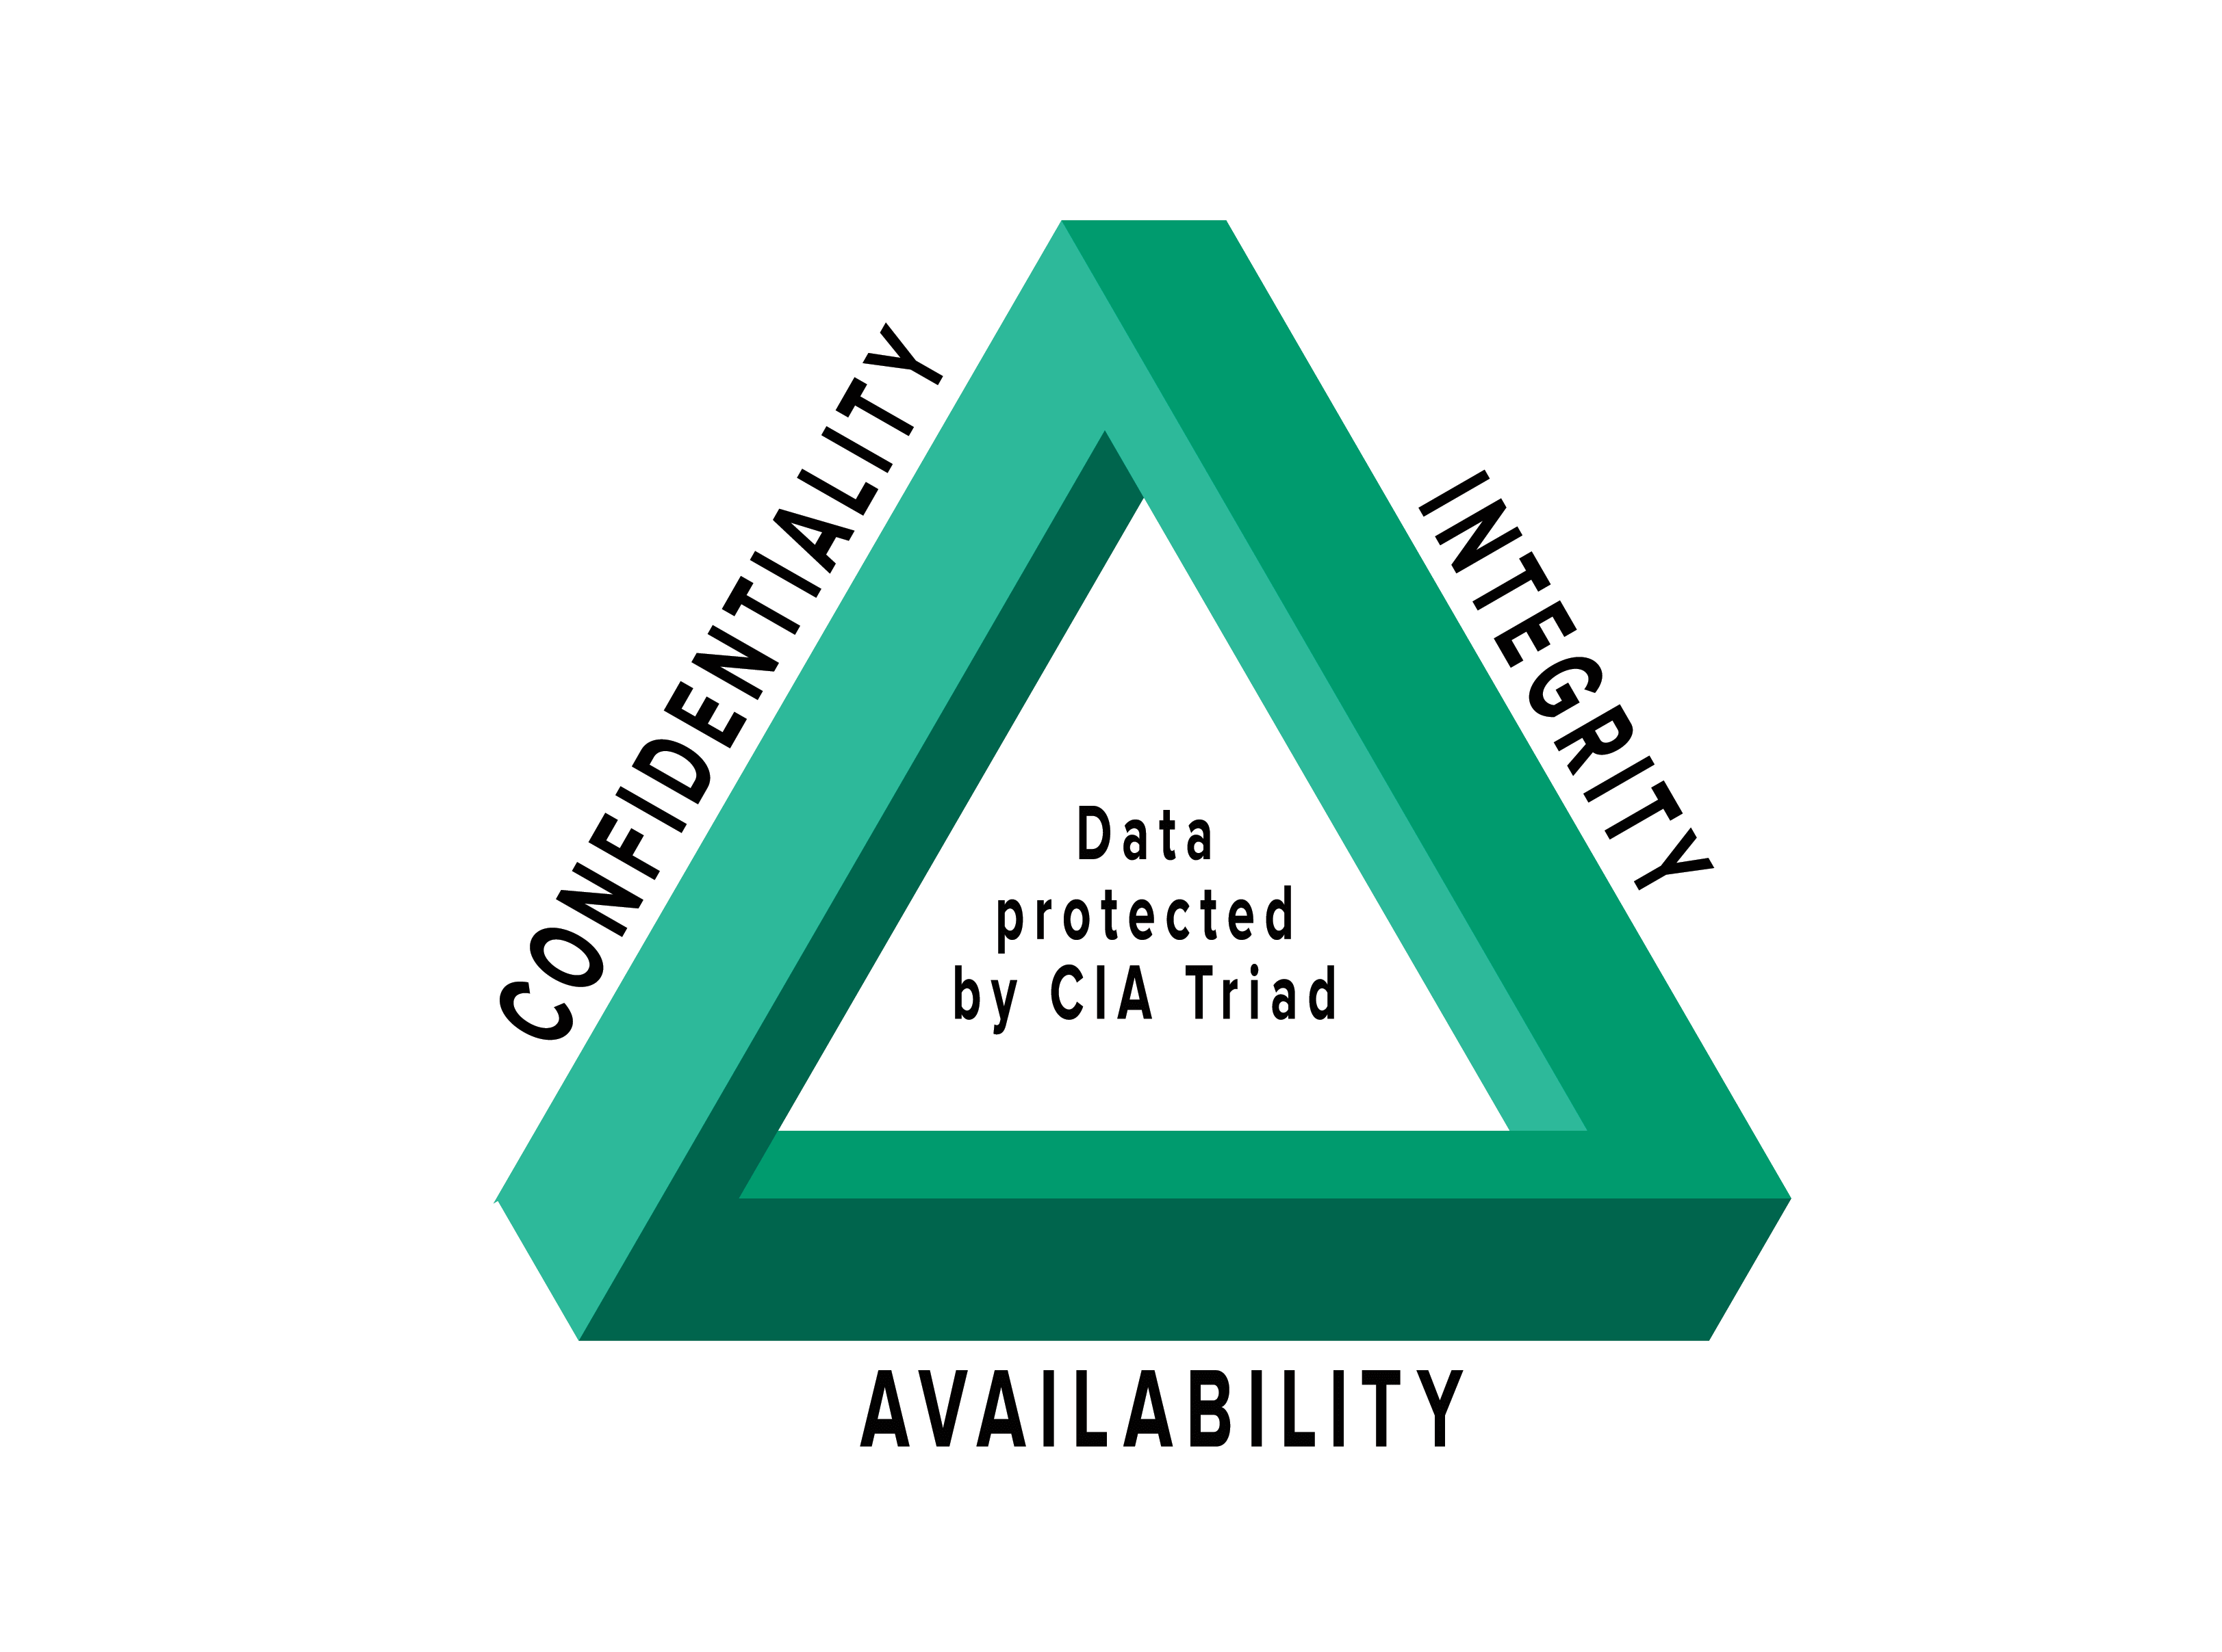
Actionable steps for Data Security
Confidentiality
Integrity
Availability
Notes:
Confidentiality involves preventing unauthorized access to sensitive data to keep it from reaching the wrong people. Educating your employees will help identify who should be accessing certain data.
Integrity – surrounds protecting data from improper data erasure or modification – having proper tools and softwares in places can ensure this as well as ensuring the storage of data.
Availabiltiy - equires ensuring that security controls, computer systems and software all work properly to ensure that services and information systems are available when needed

Slide 11
Future work needed
How can we deal with rising cyber attack rates?
Is our data truly safe?

Slide 12
Questions?

Slide 13
Research
Capers, Z. (2019). get app. Retrieved from https://www.getapp.com/resources/common-encryption-methods/
Checkpoint. (2019). What is a Firewall? Retrieved from Checkpoint: https://www.checkpoint.com/cyber-hub/network-security/what-is-firewall/#:~:text=A%20Firewall%20is%20a%20network,network%20and%20the%20public%20Internet.
Humayun, M., Niazi, M., Jhanjhi, N. Z., Alshayeb, M., & Mahmood, S. (2020). Cyber security threats and vulnerabilities: a systematic mapping study. Arabian Journal for Science and Engineering, 45(4), 3171-3189.
Hobbs, A. (2021). The colonial pipeline hack: Exposing vulnerabilities in us cybersecurity. SAGE Publications: SAGE Business Cases Originals.
Mohurle, S., & Patil, M. (2017). A brief study of wannacry threat: Ransomware attack 2017. International Journal of Advanced Research in Computer Science, 8(5), 1938-1940.
Kaufman. (2009). Data Security in the World of Cloud Computing.
Kemper, G. (2019). Improving employees' cyber security awareness.
Li, Q., & Clark, G. (2013). Mobile security: A look ahead. IEEE Security & Privacy, 11(1), 78-81.
Sumina, V. (2022). 26 Cloud Computing Statistics, Facts & Trends for 2022. Retrieved from Cloudwards: https://www.cloudwards.net/cloud-computing-statistics/

